Slide 1
System Analysis and Design
Data Flow Diagram(DFD)
Dr. Shah Murtaza Rashid Al Masud
CSE Department
UAP

Slide 2
What is a Data Flow Diagram?
A data flow diagram (DFD) is a graphical representation of the movement of data between external entities, processes and data stores within a system.
Simply put, DFD’s show how data moves through an information system.

Slide 3











The Flow Model/Basic Structure
Every computer-based system is an information transform ....
4

Slide 4
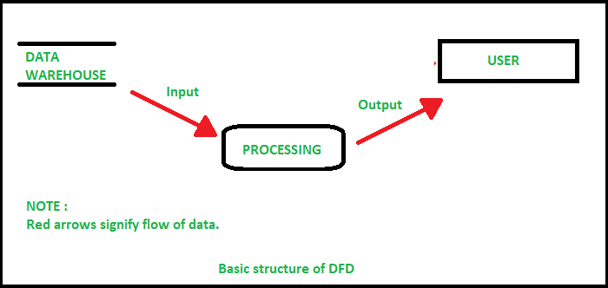
The Flow Model/Basic Structure
4

Slide 5
Definitions and Symbols
Process: work or actions performed on data (inside the system) (circle/bubble chart)
Data store: data at rest (inside the system) (open rectangle)
Source/sink: external entity that is the origin or destination of data (outside the system) (square box)
Data flow: arrows depicting movement of data (arrow/line)
Notes:
The process is some task taking place. We generally think of DFDs are representing computer systems, but it can also represent work flows in an organization. So, processes could represent computer activities or human activities, or a combination of both.
The data store will generally be a file or a database. Unless, of course, this is a manual system. In that case, the data store could be a file cabinet containing paper documents.

Slide 6
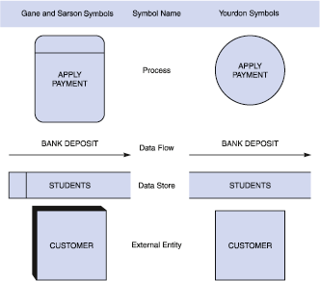

Slide 7
Process
The work or actions performed on data so that they are transformed, stored, or distributed.
Process labels should be verb phrases!

Slide 8
Process example
Examples: compute taxes, determine area, format report, display graph
Data must always be processed in some way to achieve system function
8

Slide 9
Data Flow
A path for data to move from one part of the system to another.
Data in motion!
Arrows depict the movement of data.
NO VERBS

Slide 10







Data Flow Example
Data flows through a system, beginning as input and transformed into output.
base
area
height
9

Slide 11
Data Store
Used in a DFD to represent data that the system stores
Data at rest!
Labels should be noun phrases
(NO VERBS)

Slide 12








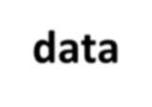




Data Stores Example
Data is often stored for later use.
sensor #
sensor #, type, location, age
report required
type, location, age
sensor number
sensor data
10

Slide 13
External Entity aka Source/Sink
The origin or destination of data!
This represents things outside of the system.
Source – Entity that supplies data to the system.
Sink – Entity that receives data from the system.
The labels should be noun phrases!

Slide 14






External Entity Example
A producer or consumer of data
Examples: a person, a device, a sensor
Another example: computer-based system
Data must always originate somewhere and must always be sent to something
7

Slide 15
DFD Rules and Tips
Each process should have at least one input and an output.
Each data store should have at least one data flow in and one data flow out.
Data stored in a system must go through a process.
All processes in a DFD go to another process or a data store.

Slide 16
DFD Rules and Tips
YES
NO
A process to another process
A process to an external entity
A process to a data store
An external entity to another external entity
An external entity to a data store
A data store to another data store

Slide 17
DFD vs. ERD
DFD | ERD
It stands for Data Flow Diagram. | It stands for Entity Relationship Diagram or Model.
Main objective is to represent the processes and data flow between them. | Main objective is to represent the data object or entity and relationship between them.
It explains the flow and process of data input, data output, and storing data. | It explains and represent the relationship between entities stored in a database.
Symbols used in DFD are: rectangles (represent the data entity), circles (represent the process), arrows (represent the flow of data), ovals or parallel lines (represent data storing). | Symbols used in ERD are: rectangles (represent the entity), diamond boxes (represent relationship), lines and standard notations (represent cardinality).
Rule followed by DFD is that at least one data flow should be there entering into and leaving the process or store. | Rule followed by ERD is that all entities must represent the set of similar things.
It models the flow of data through a system. | It model entities like people, objects, places and events for which data is stored in a system.

Slide 18
DFD levels and layers:
From context diagrams to pseudocode
A data flow diagram can dive into progressively more detail by using levels and layers, zeroing in on a particular piece.
DFD levels are numbered 0, 1 or 2, and occasionally go to even Level 3 or beyond.

Slide 19
DFD 0
It is also known as a context diagram. It’s designed to be an abstraction view, showing the system as a single process with its relationship to external entities. It represents the entire system as a single bubble with input and output data indicated by incoming/outgoing arrows.

Slide 20
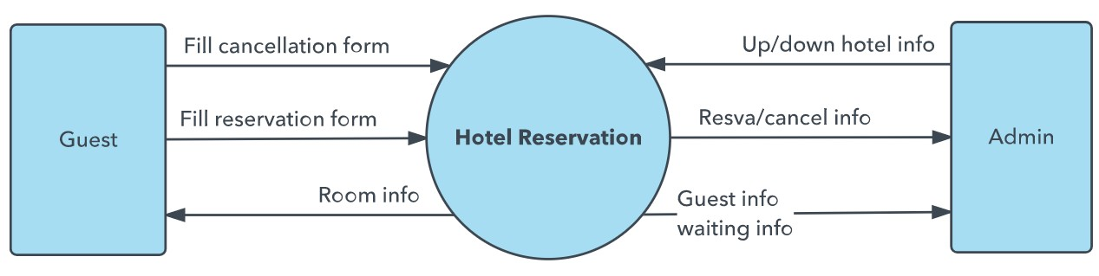
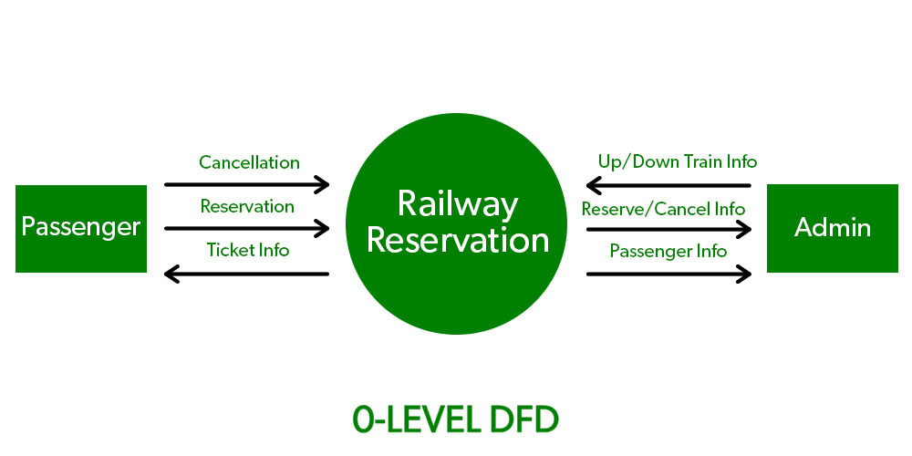
DFD 0

Slide 21
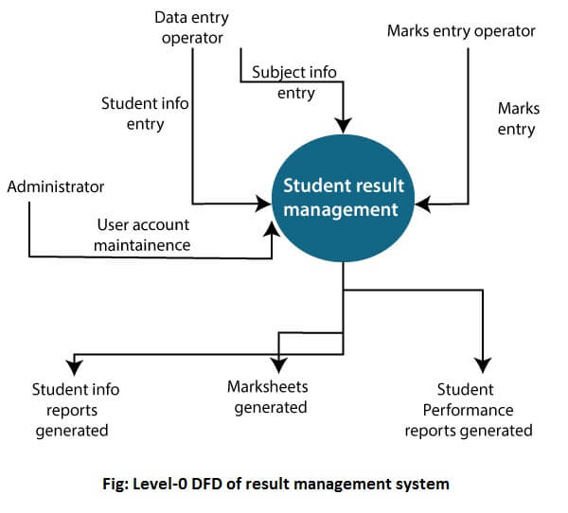
DFD 0

Slide 22
DFD-1
In 1-level DFD, the context diagram is decomposed into multiple bubbles/processes. In this level, we highlight the main functions of the system and breakdown the high-level process of 0-level DFD into sub-processes.

Slide 23
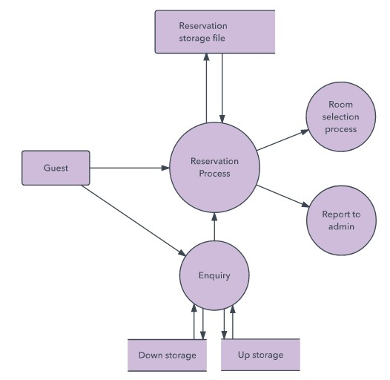
DFD-1

Slide 24
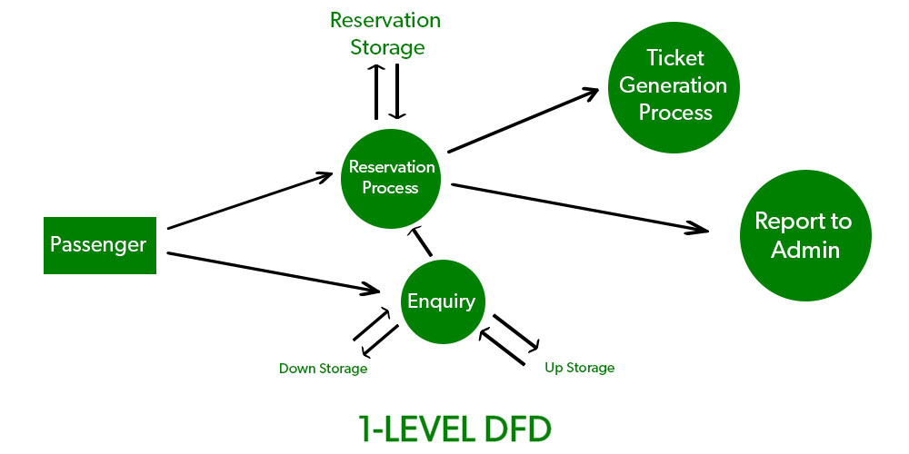
DFD-1

Slide 25
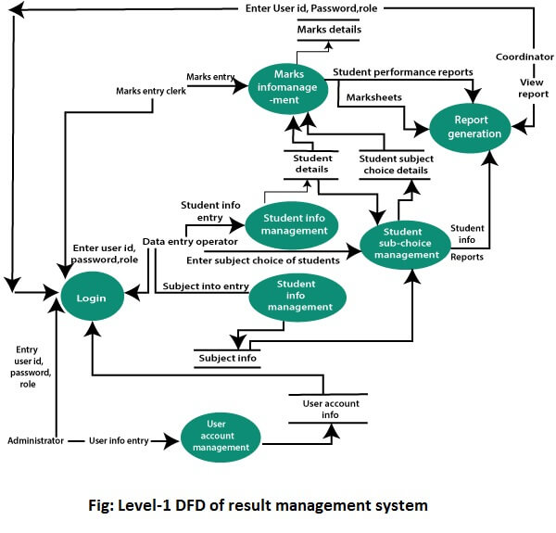
DFD-1

Slide 26
DFD-2
2-level DFD goes one step deeper into parts of 1-level DFD. It can be used to plan or record the specific/necessary detail about the system’s functioning.

Slide 27
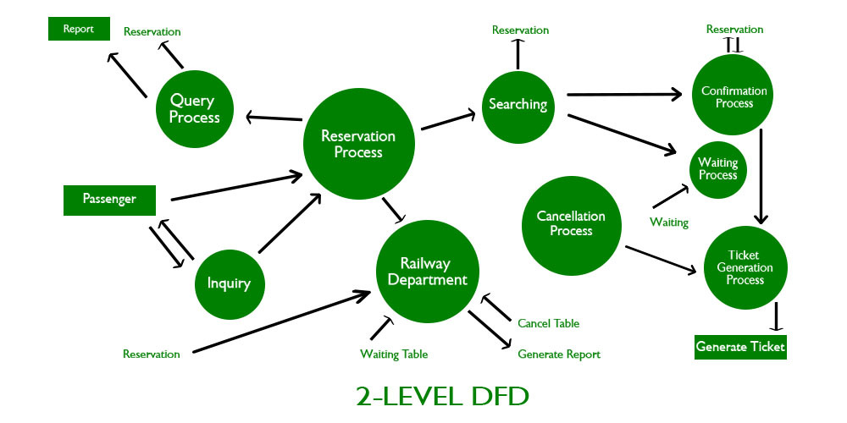
DFD-2

Slide 28
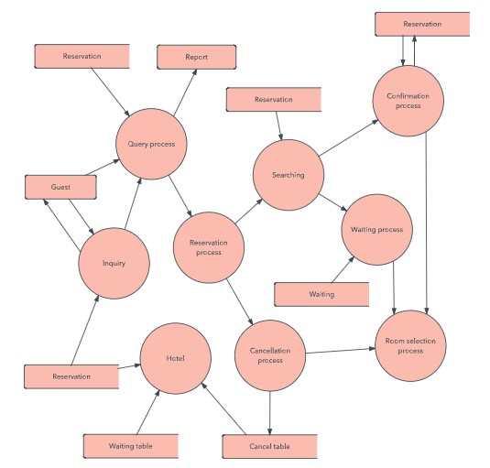
DFD-2

Slide 29
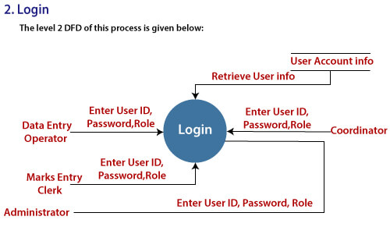
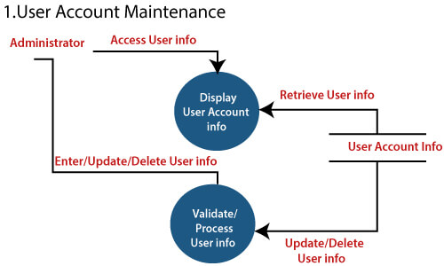
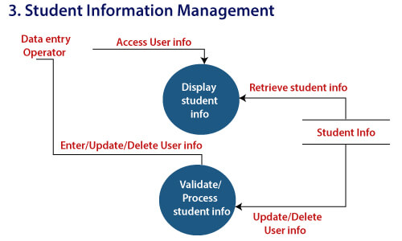
DFD-2, Result Management System

Slide 30
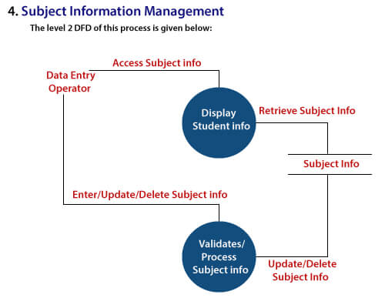
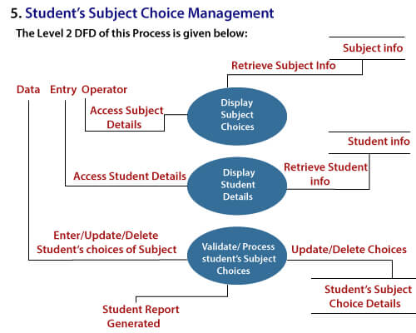
DFD-2

Slide 31
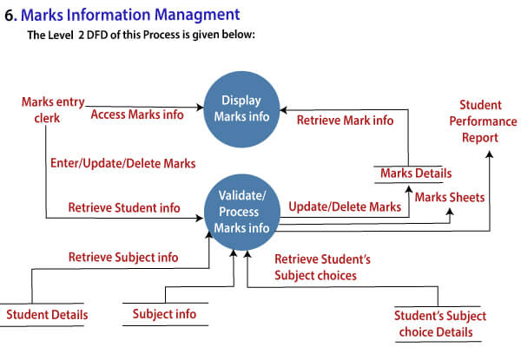
DFD-2

Slide 32
DFD 3, 4
Progression to Levels 3, 4 and beyond is possible, but going beyond Level 3 is uncommon.
Doing so can create complexity that makes it difficult to communicate, compare or model effectively.

Slide 33
Developing/Creating Data Flow Diagrams
Steps:
Create a list of activities
Construct Context Level/Level 0 DFD (identifies external entities and processes)
Construct Level 1 DFD (identifies manageable sub process )
Construct Level 2- n DFD (identifies actual data flows and data stores )
Check against rules of DFD

Slide 34
DFD Naming Guidelines
External Entity → Noun
Data Flow → Names of data
Process → verb phrase
a system name
a subsystem name
Data Store → Noun

Slide 35
Developing/Creating Data Flow Diagrams
Lemonade Stand Example

Slide 36
Creating Data Flow Diagrams
Example
Steps:
The operations of a simple lemonade stand will be used to demonstrate the creation of dataflow diagrams.
Create a list of activities
Old way: no Use-Case Diagram
New way: use Use-Case Diagram
Construct Context Level/Level 0 DFD (identifies sources and sink)
Construct Level 1 DFD (identifies manageable sub processes )
Construct Level 2- n DFD (identifies actual data flows and data stores )

Slide 37
Creating Data Flow Diagrams
Example
Create a list of activities
Think through the activities that take place at a lemonade stand.
Customer Order
Serve Product
Collect Payment
Produce Product
Store Product

Slide 38
Creating Data Flow Diagrams
Example
Create a list of activities
Also think of the additional activities needed to support the basic activities.
Customer Order
Serve Product
Collect Payment
Produce Product
Store Product
Order Raw Materials
Pay for Raw Materials
Pay for Labor

Slide 39
Creating Data Flow Diagrams
Example
Create a list of activities
Group these activities in some logical fashion, possibly functional areas.
Customer Order
Serve Product
Collect Payment
Produce Product
Store Product
Order Raw Materials
Pay for Raw Materials
Pay for Labor

Slide 40
Creating Data Flow Diagrams
Example
Construct Context Level/Level 0 DFD (identifies sources and sink)
Create a context level diagram identifying the sources and sinks (users).
Context Level DFD
CUSTOMER
0.0
Lemonade System
Sales Forecast
EMPLOYEE
Order
Customer Order
Serve Product
Collect Payment
Produce Product
Store Product
Order Raw Materials
Pay for Raw Materials
Pay for Labor
Production Schedule
Product Served
Pay
Payment
Time Worked
Received Goods
Payment
Purchase Order
VENDOR

Slide 41
Creating Data Flow Diagrams
Example
Construct Level 1 DFD (identifies manageable sub processes )
Create a level 0 diagram identifying the logical subsystems that may exist.
Level 1 DFD
1.0
Sale
Customer Order
Serve Product
Collect Payment
Produce Product
Store Product
Order Raw Materials
Pay for Raw Materials
Pay for Labor
Customer Order
Sales Forecast
Product Ordered
CUSTOMER
Payment
2.0
Production
EMPLOYEE
Production Schedule
Product Served
Received Goods
Inventory
VENDOR
3.0
Procure-ment
Purchase Order
Order Decisions
Payment
Pay
Time Worked
4.0
Payroll

Slide 42

Creating Data Flow Diagrams
Example
Construct Level 2- n DFD (identifies actual data flows and data stores )
Create a level 1 decomposing the processes in level 0 and identifying data stores.
Level 2 DFD
CUSTOMER
Customer Order
Customer Order
Serve Product
Collect Payment
Produce Product
Store Product
Order Raw Materials
Pay for Raw Materials
Pay for Labor
ORDER
Request for Forecast
1.1
Record Order
1.3
Produce Sales Forecast
Severed Order
Payment
Sales Forecast
1.2
Receive Payment
PAYMENT

Slide 43

Creating Data Flow Diagrams
Example
Construct Level 2 (continued)
Create a level 1 decomposing the processes in level 0 and identifying data stores.
Level 2 DFD
Product Order
ORDER
Customer Order
Serve Product
Collect Payment
Produce Product
Store Product
Order Raw Materials
Pay for Raw Materials
Pay for Labor
2.1
Serve Product
Quantity Severed
RAW MATERIALS
Production Schedule
2.2
Produce Product
Quantity Used
INVENTORTY
Production Data
2.3
Store
Product
Quantity Produced & Location Stored

Slide 44

Creating Data Flow Diagrams
Example
Construct Level 2 (continued)
Create a level 1 decomposing the processes in level 0 and identifying data stores.
Level 2 DFD
Order Decision
3.1
Produce Purchase Order
PURCHASE ORDER
Customer Order
Serve Product
Collect Payment
Produce Product
Store Product
Order Raw Materials
Pay for Raw Materials
Pay for Labor
Quantity On-Hand
RAW MATERIALS
Quantity Received
Received Goods
3.2
Receive Items
RECEIVED ITEMS
Payment Approval
3.3
Pay Vendor
VENDOR
Payment

Slide 45
Creating Data Flow Diagrams
Example
Construct Level 2 (continued)
Create a level 1 decomposing the processes in level 0 and identifying data stores.
Level 2 DFD
Time Worked
4.1
Record Time Worked
TIME CARDS
Customer Order
Serve Product
Collect Payment
Produce Product
Store Product
Order Raw Materials
Pay for Raw Materials
Pay for Labor
Employee ID
EMPLOYEE
Payroll Request
4.2
Calculate Payroll
Unpaid time cards
PAYROLL
Payment Approval
4.3
Pay Employee
PAYMENTS
Payment

Slide 46
Process Decomposition
1.0
Sale
1.1
Record Order
1.2
Receive Payment
2.0
Production
2.1
Serve Product
2.2
Produce Product
2.3
Store
Product
0.0
Lemonade System
3.0
Procure-ment
3.1
Produce Purchase Order
3.2
Receive Items
3.3
Pay Vendor
4.0
Payroll
4.1
Record Time Worked
4.2
Calculate Payroll
4.3
Pay Employee
Context Level/Level 0
Level 1
Level 2

Slide 47
Advantages of DFDs
Simple graphical techniques which are easy to understand
Helps define the boundaries of the system
Useful for communicating current system knowledge to users
Explains the logic behind the data flow within the system
Used as the part of system documentation file

Slide 48
References
System Analysis and Design, by Elias M. Awad
Systems Analysis and Design, Kendall and Kendall, Fifth Edition
Management Information Systems: Managing the Digital Firm (11th edition), Pearson/Prentice-Hall
https://www.visual-paradigm.com/tutorials/data-flow-
diagram-example-supermarket-app.jsp

